Slide 1
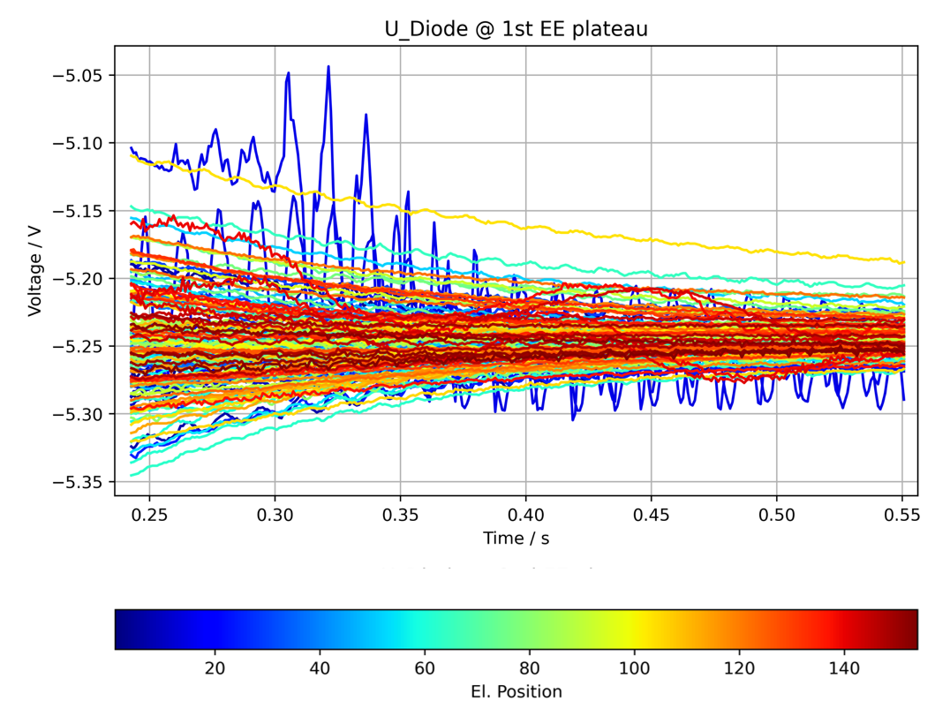
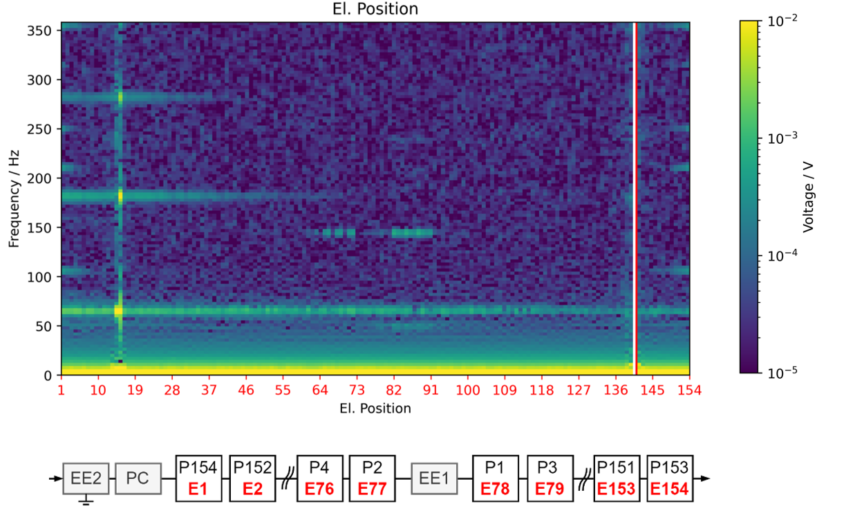
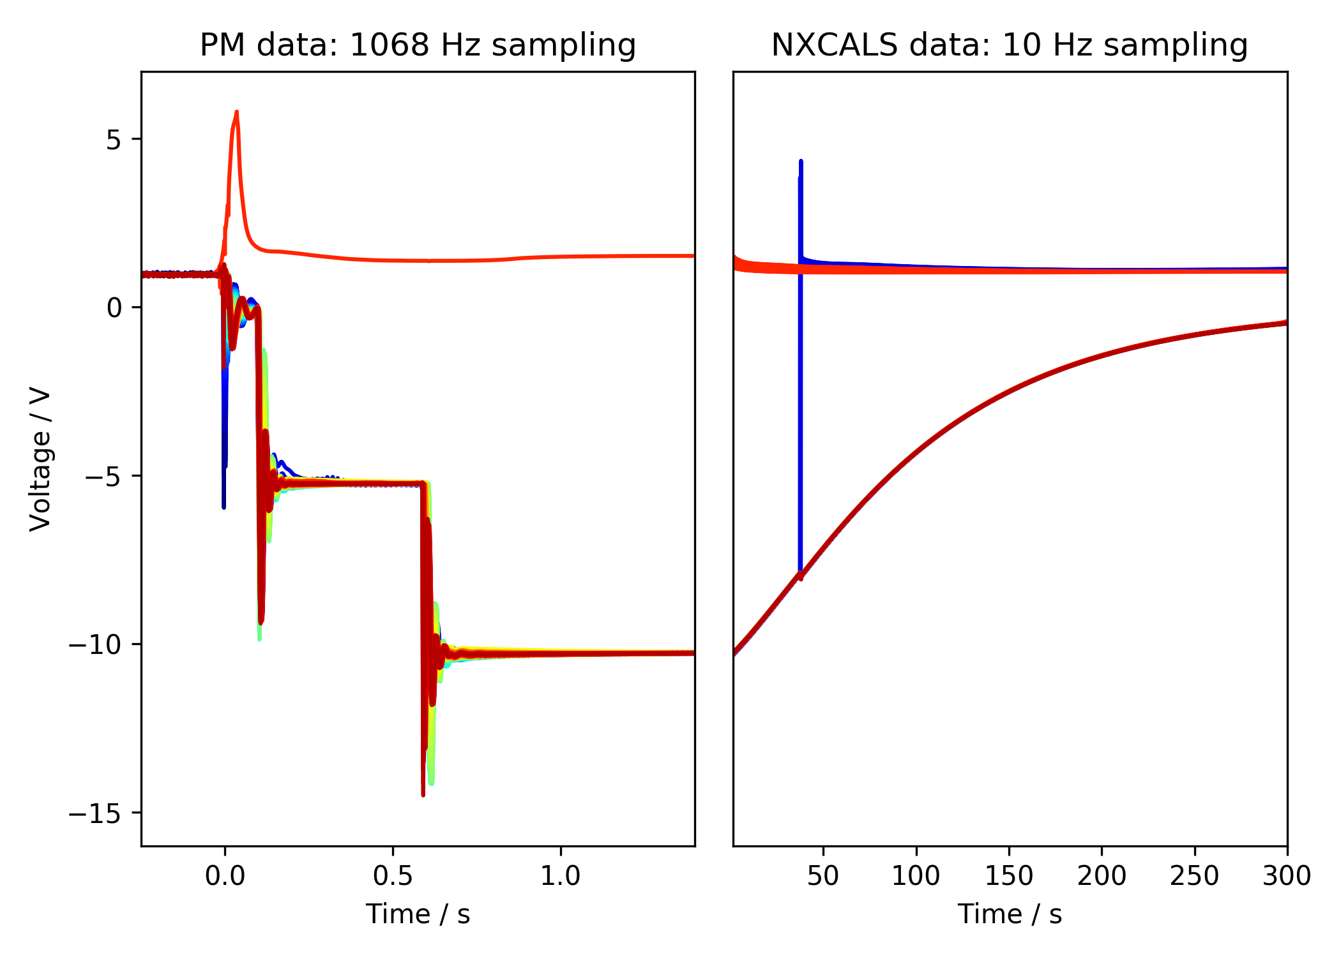
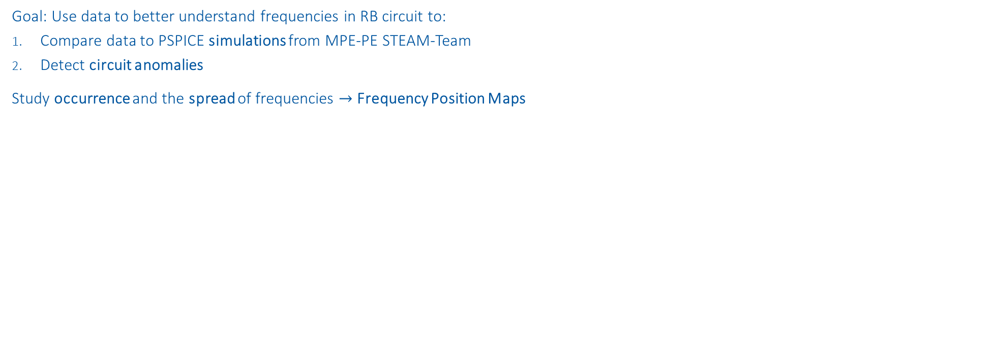
RB Frequency Analysis
Goal: Use data to better understand frequencies in RB circuit to:
Compare data to PSPICE simulations from MPE-PE STEAM-Team
Detect circuit anomalies
Study occurrence and the spread of frequencies $→$ Frequency Position Maps
1st EE
Plateau
fft
2nd EE
Plateau
2nd EE switch off
1st EE switch off
PC Switch off
Event:
RB_RB.A78_1617170255140000000 2021-03-31 07:57:35.120000 Primary Quench at el. Position 141

Slide 2
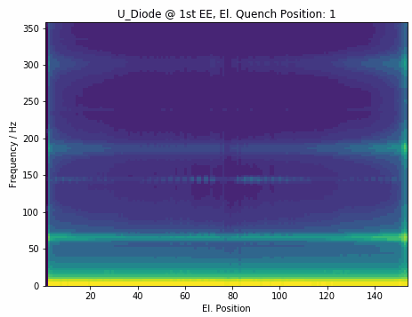
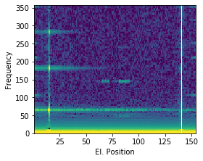
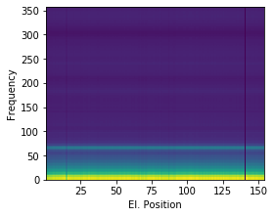
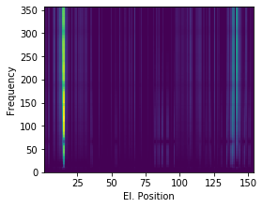
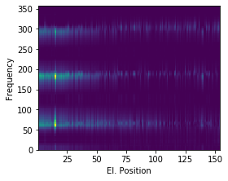
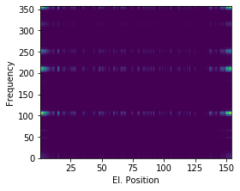
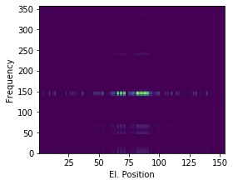





RB Frequency Analysis
Systematic approach to analyze frequencies:
Show occurrence and the spread of frequencies
Decompose frequencies based on origin
Display expected frequencies depending on a quench
$$≈$$
$$+$$
$$+$$
$$+$$
$$+$$
Common Oscillation
Physical Propagation
Electrical Propagation
Power Converter
Energy Extraction

